Slide 1
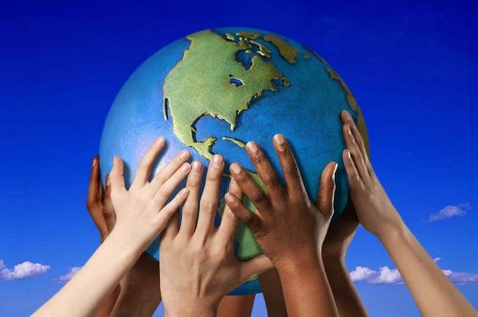
PROMOTING INCLUSIVENESS AND JUSTICE FOR ALL AMERICANS
VASFAA Conference
April 24, 2017
DAVID J. SMITH
Forage Center for Peacebuilding and Humanitarian Education
George Mason University
Peacebuilding Trainer

Slide 2
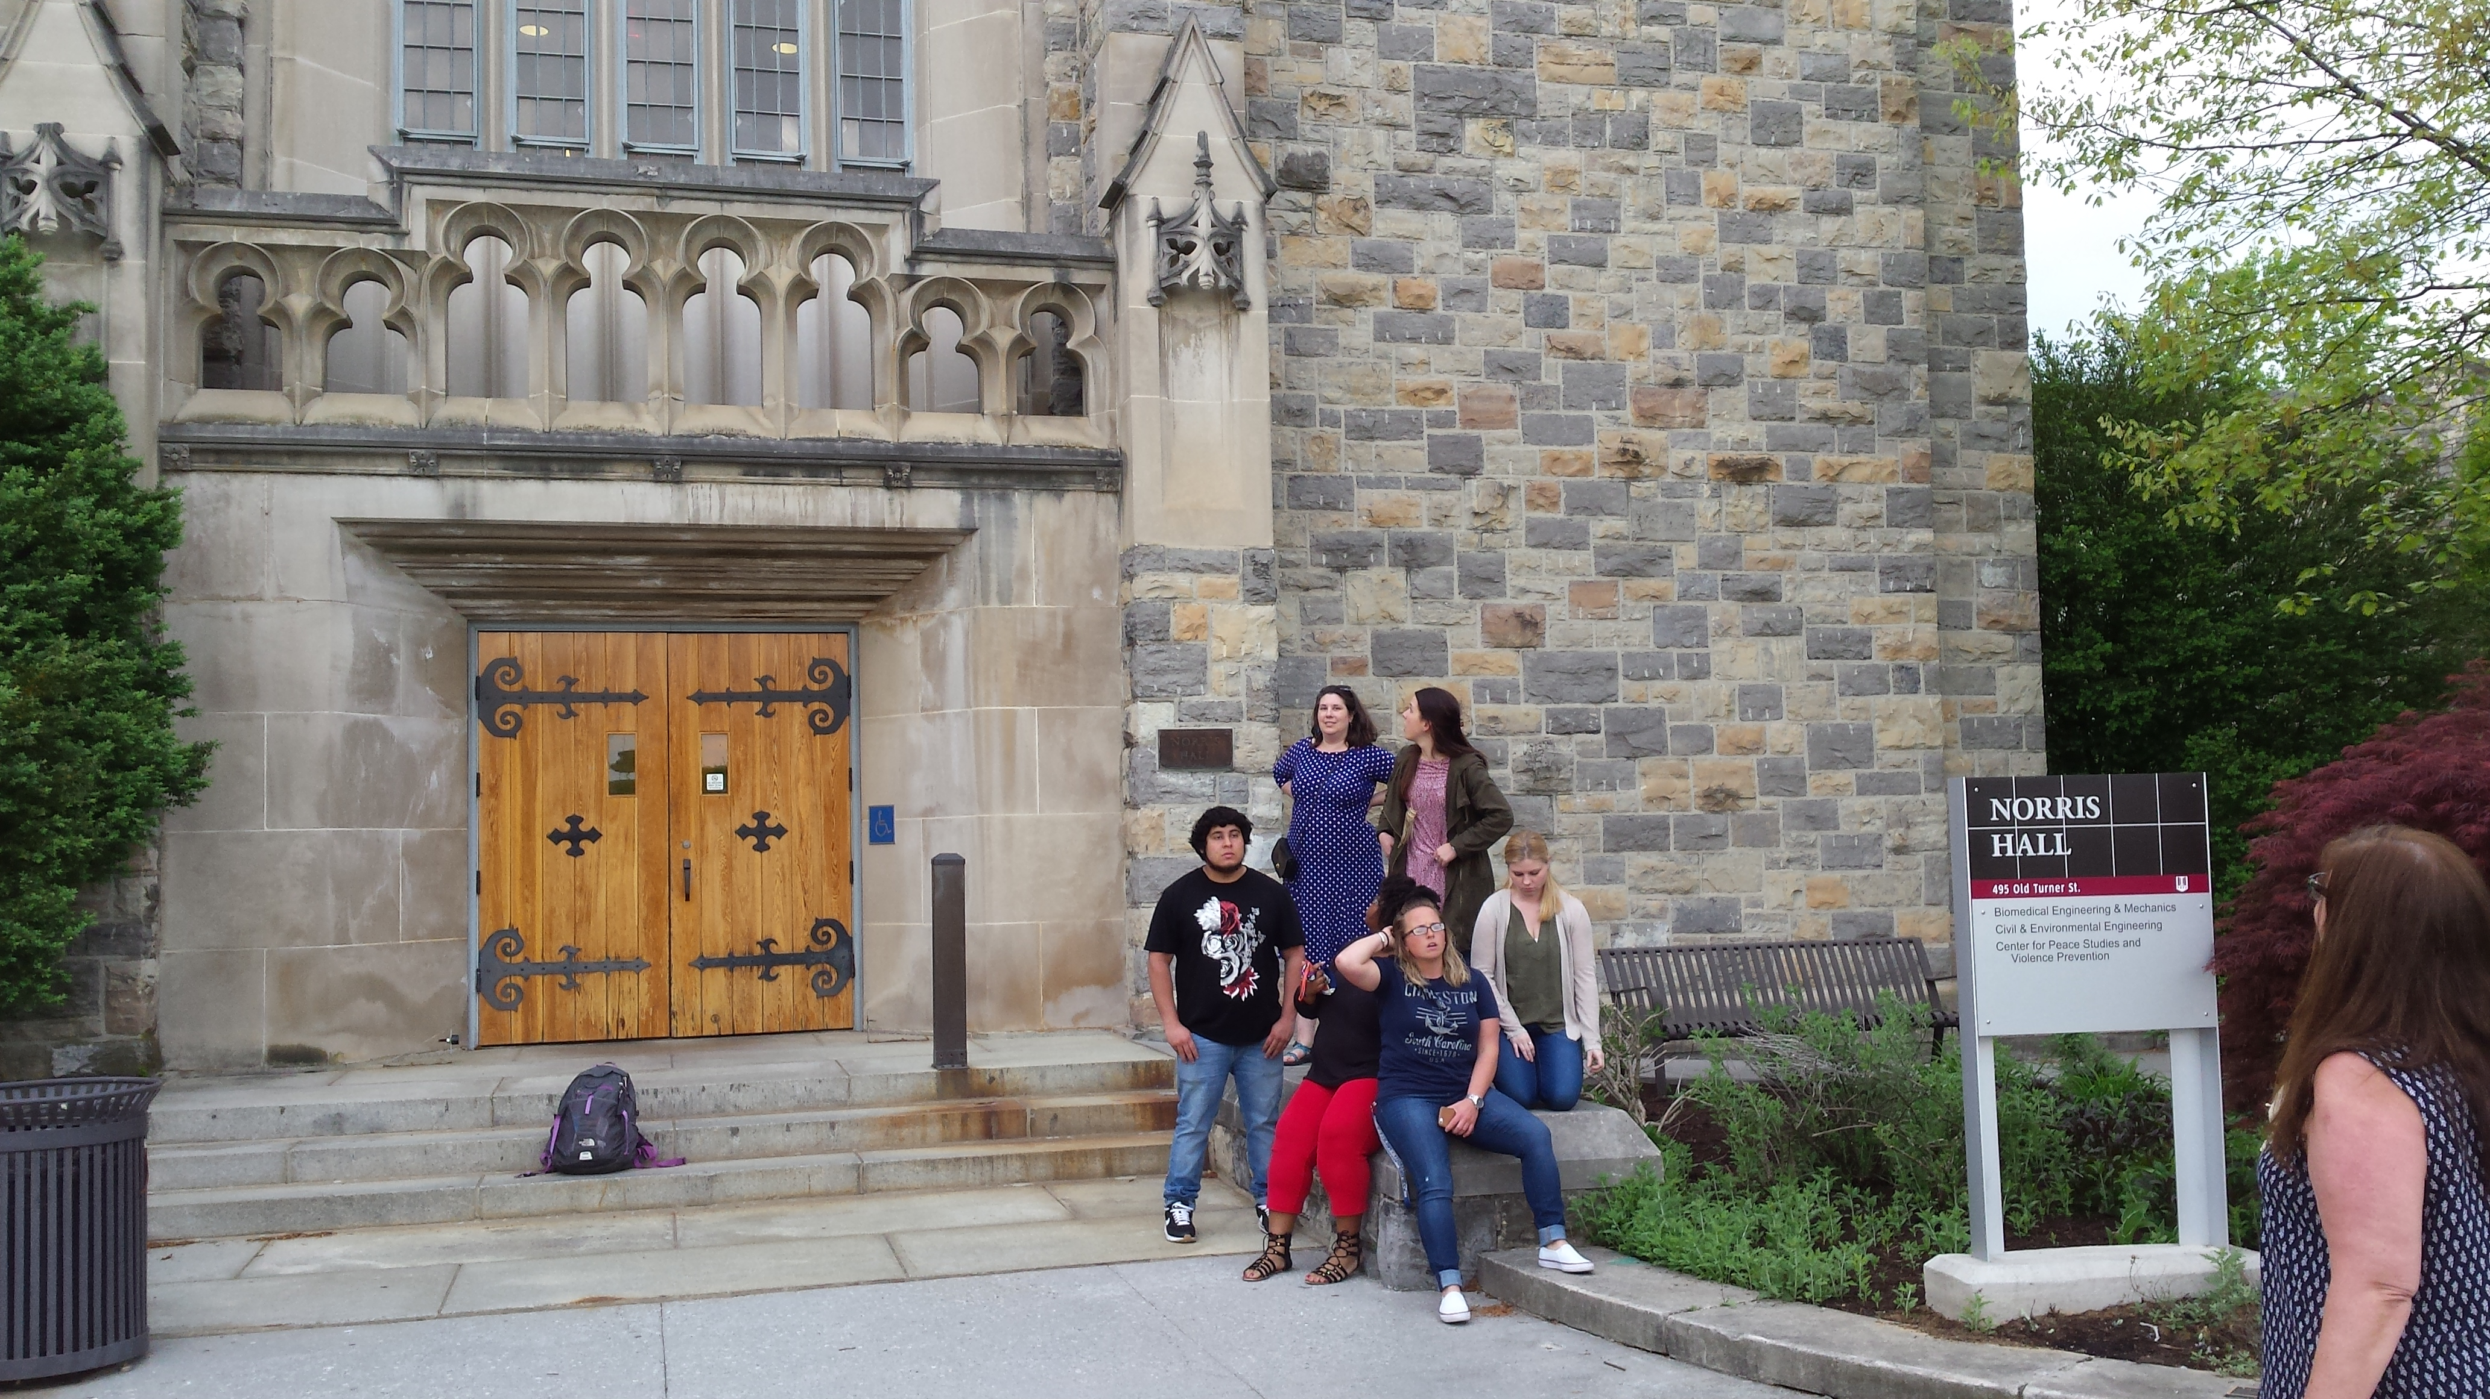

Slide 3
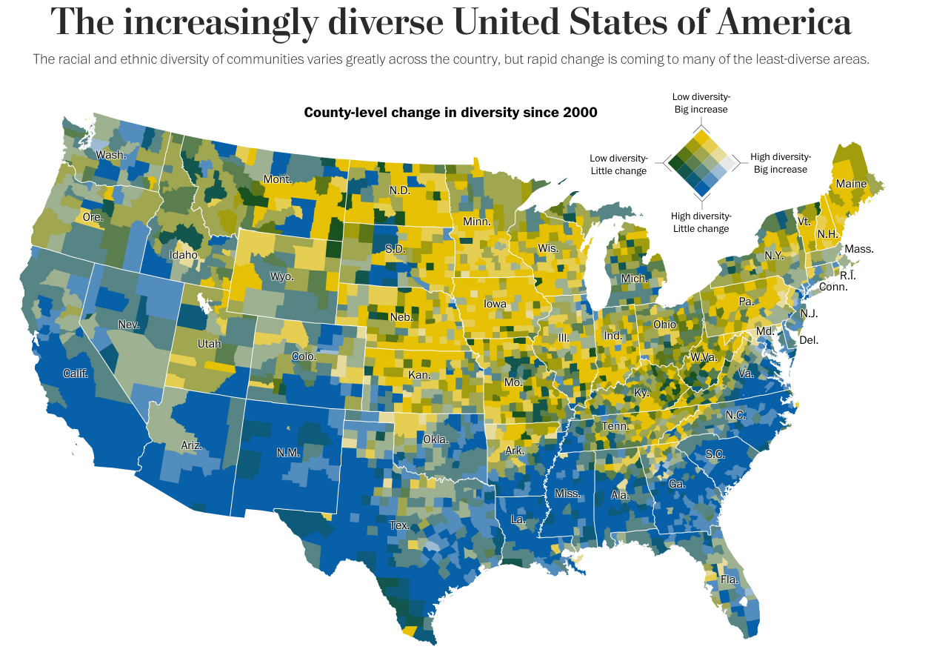
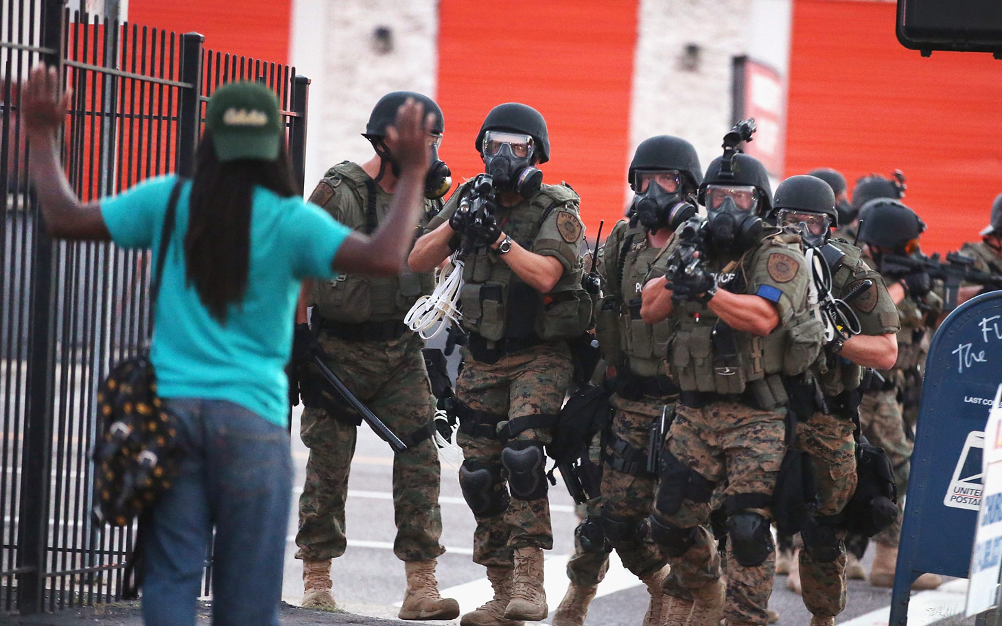

Slide 4
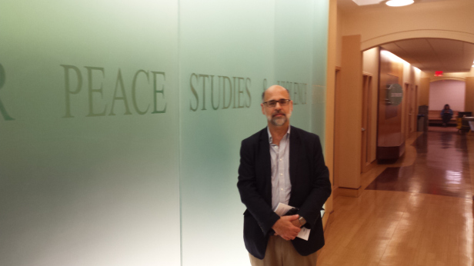

Slide 5
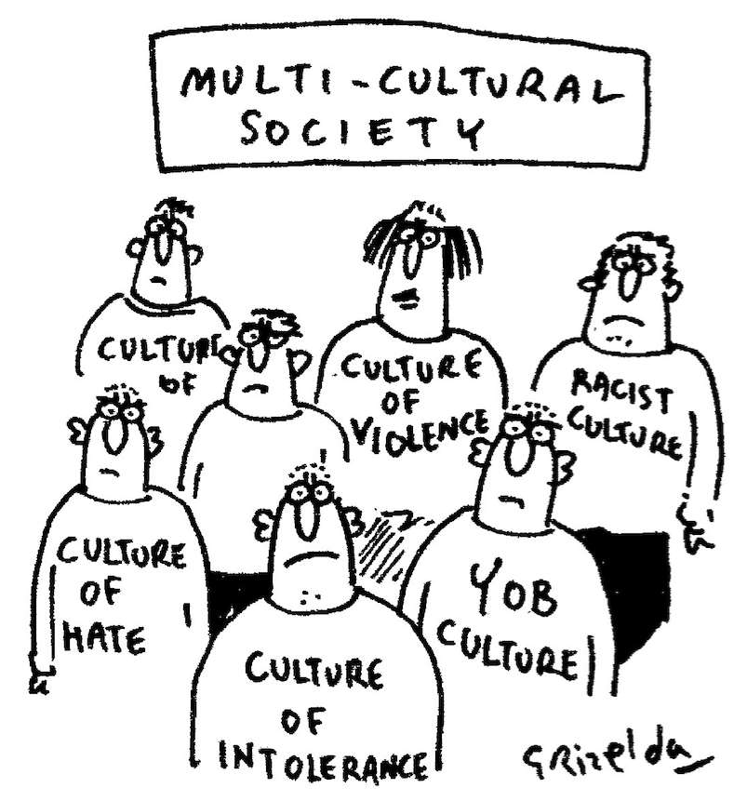
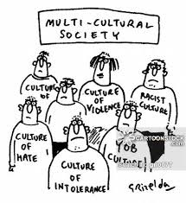

Slide 6
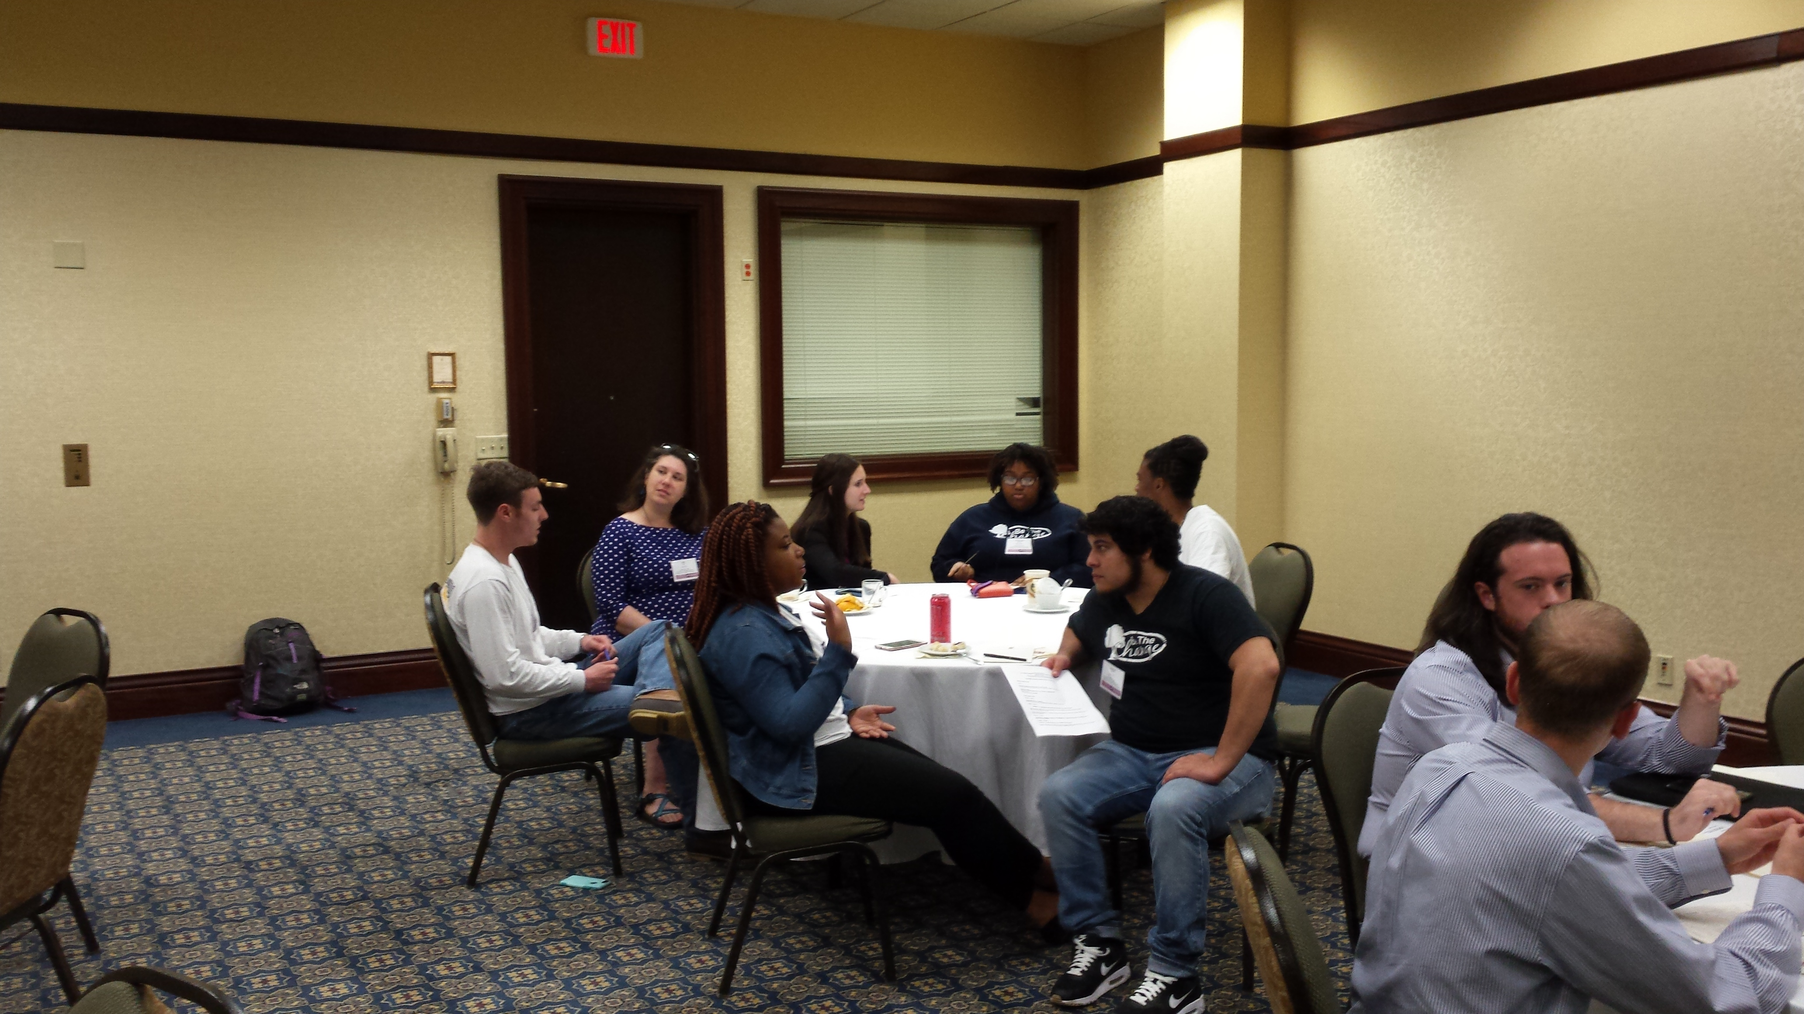

Slide 7
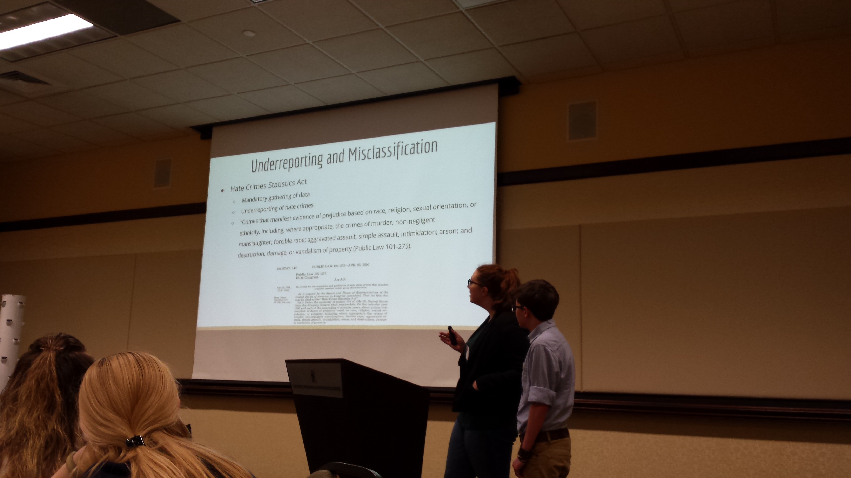

Slide 8
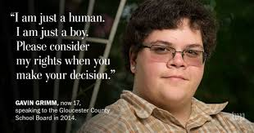

Slide 9

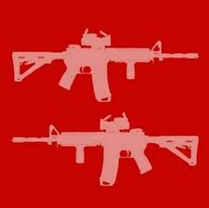

Slide 10
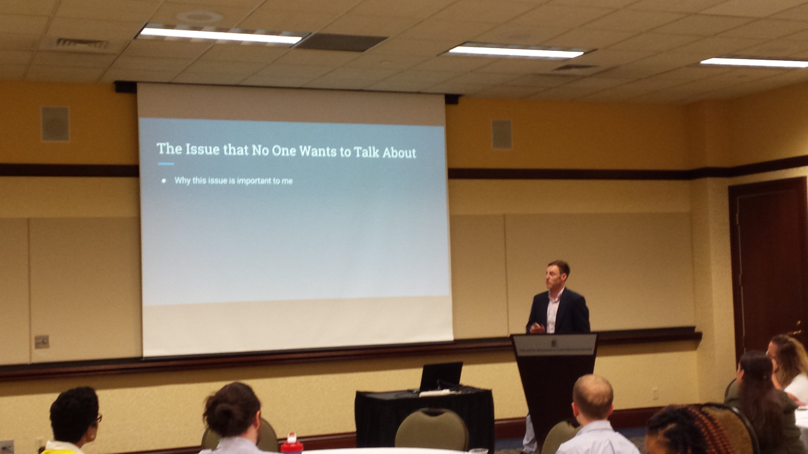

Slide 11
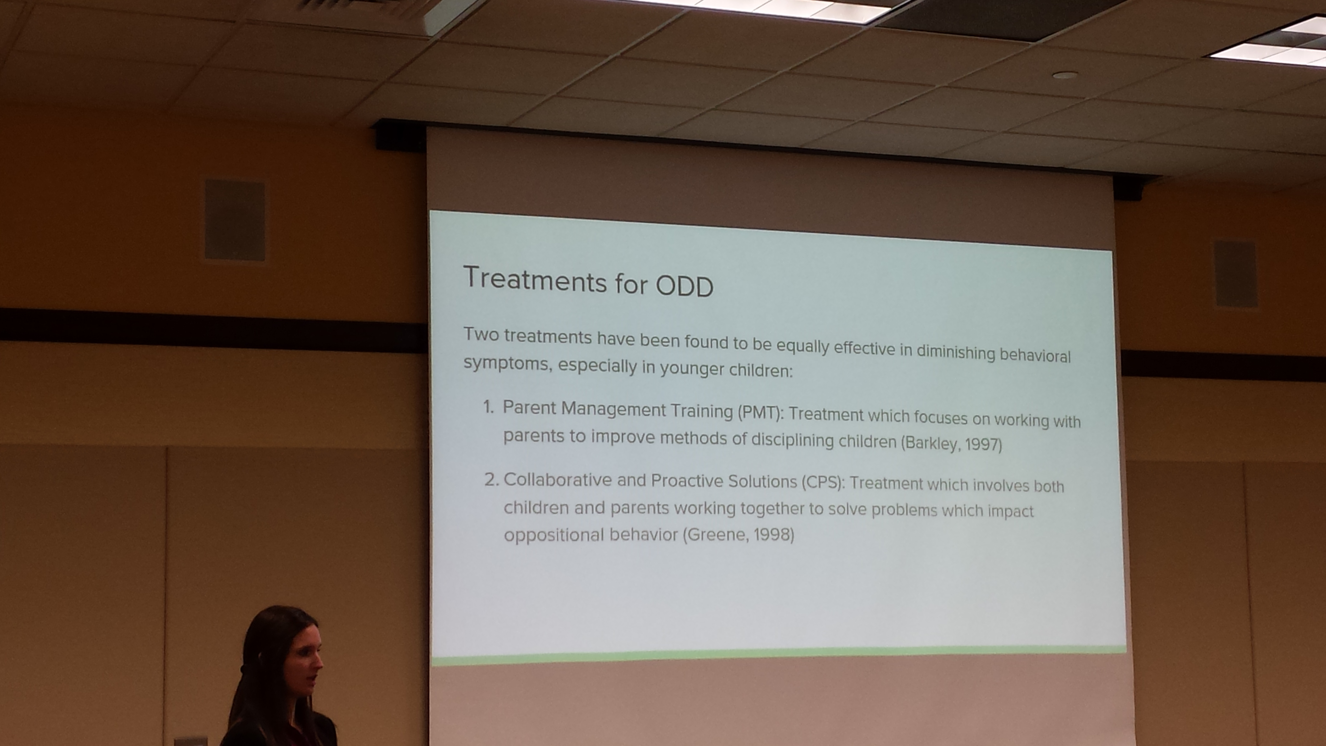

Slide 12
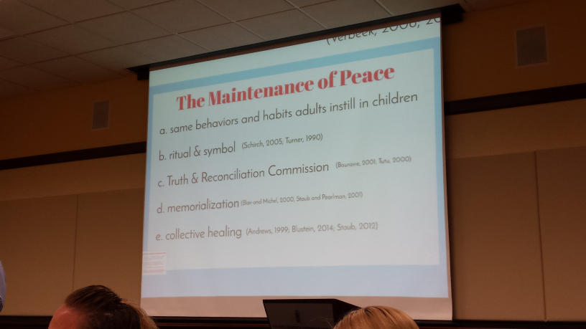

Slide 13
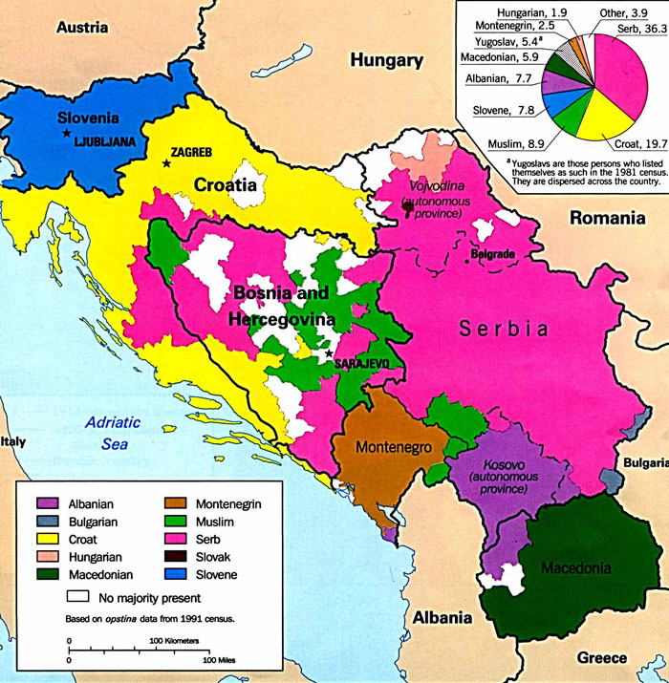

Slide 14
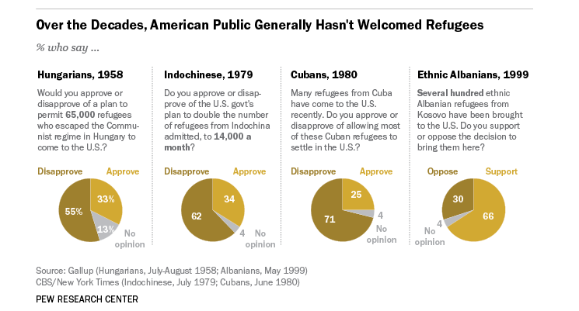

Slide 15
Refugees in FY 2016
Democratic Republic of Congo 16,380
Syria 12,587
Burma (Myanmar) 12,347
Iraq 9,880
Somalia 9,020

Slide 16
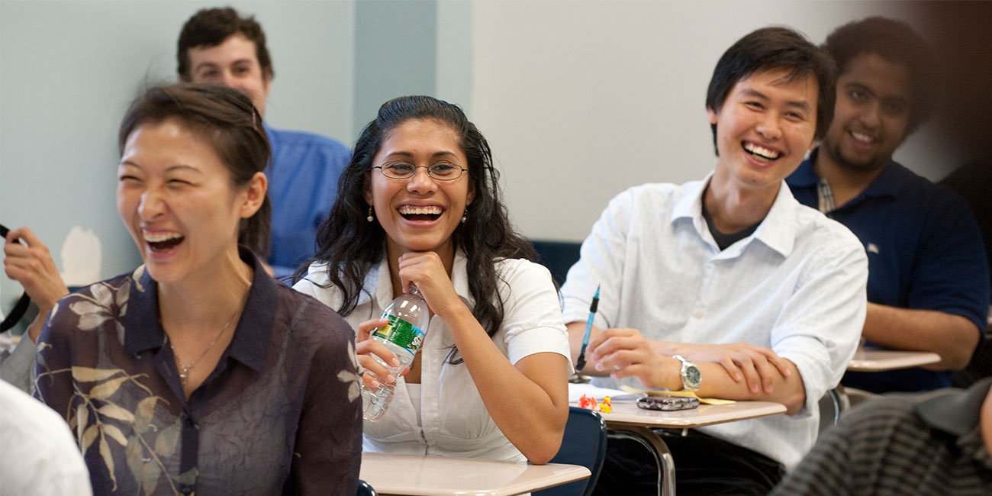

Slide 17
“A world of peace and solidarity can only be accomplished by
acknowledging and celebrating our diversity.”
-Former UN Secretary-General Ban Ki-moon

Slide 18
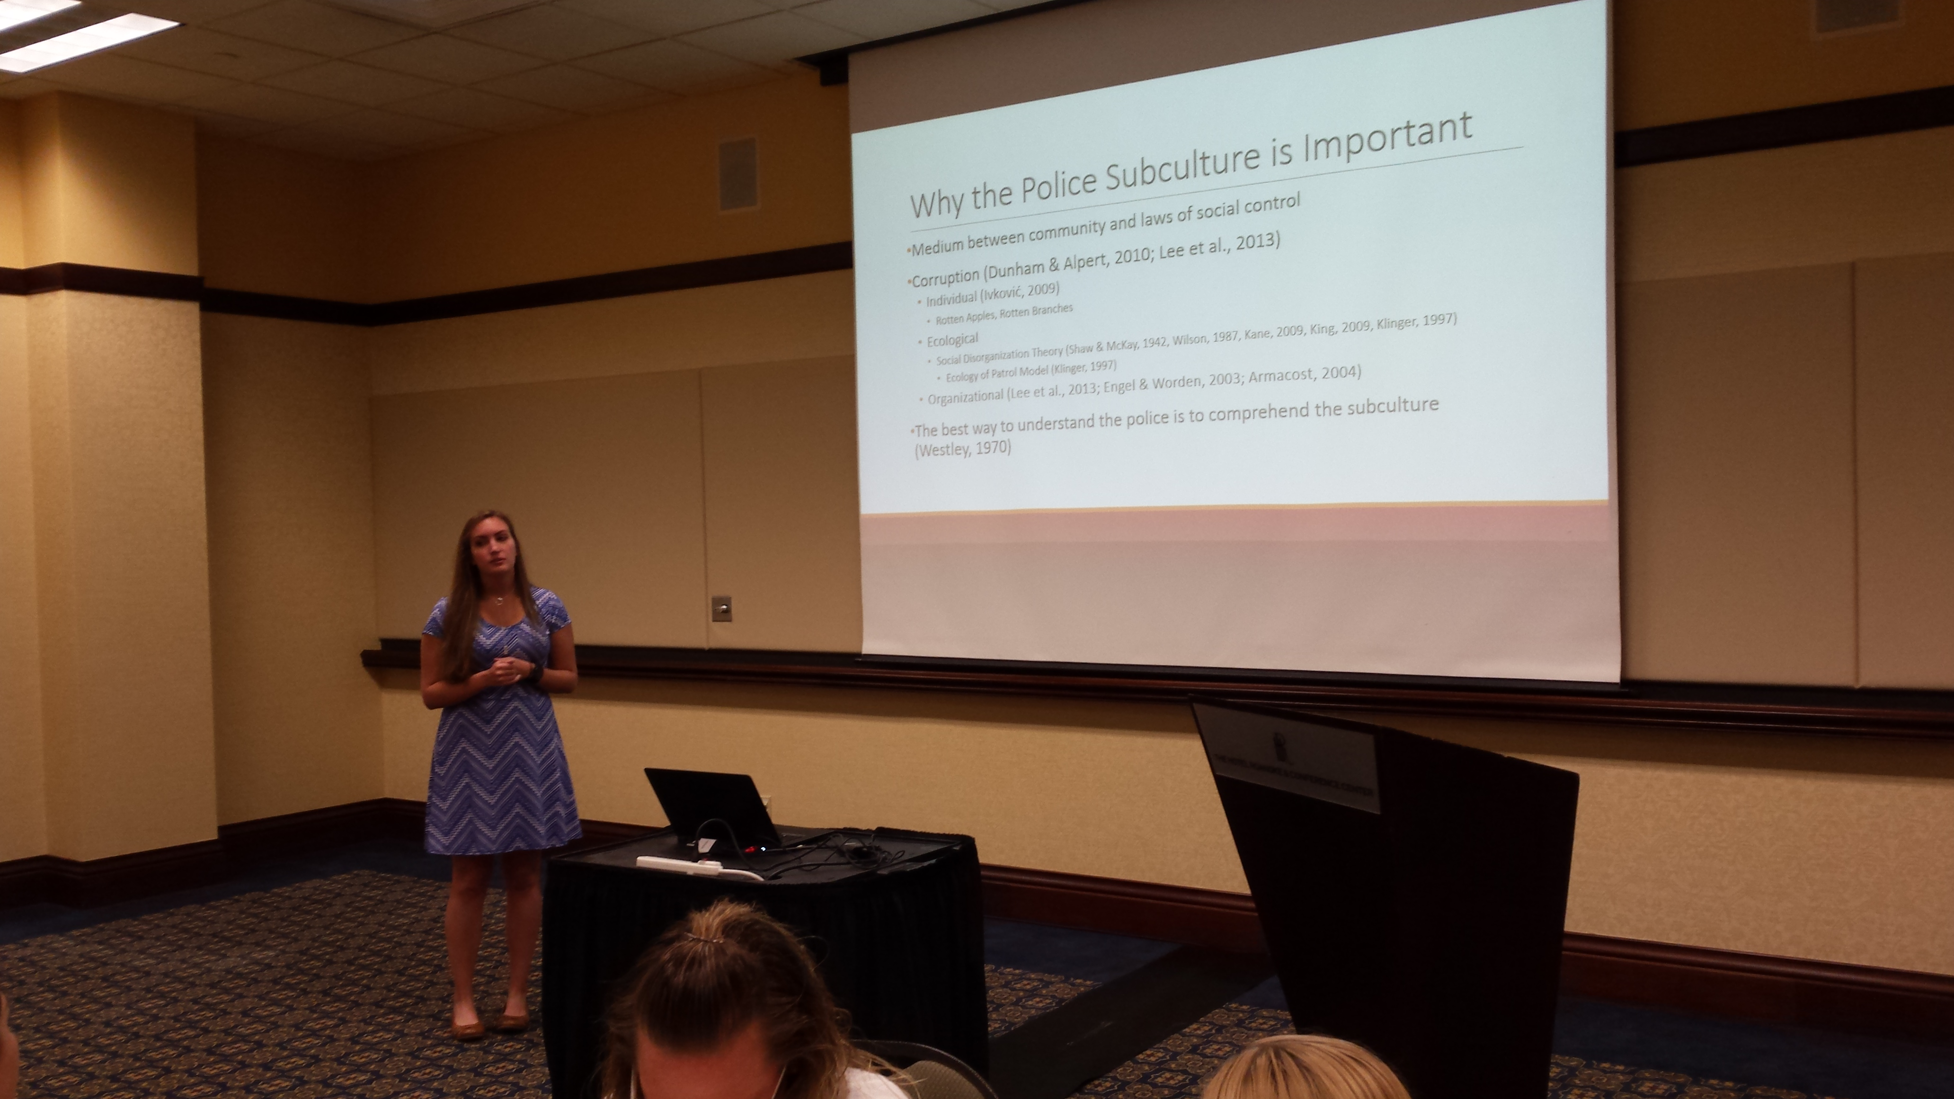

Slide 20
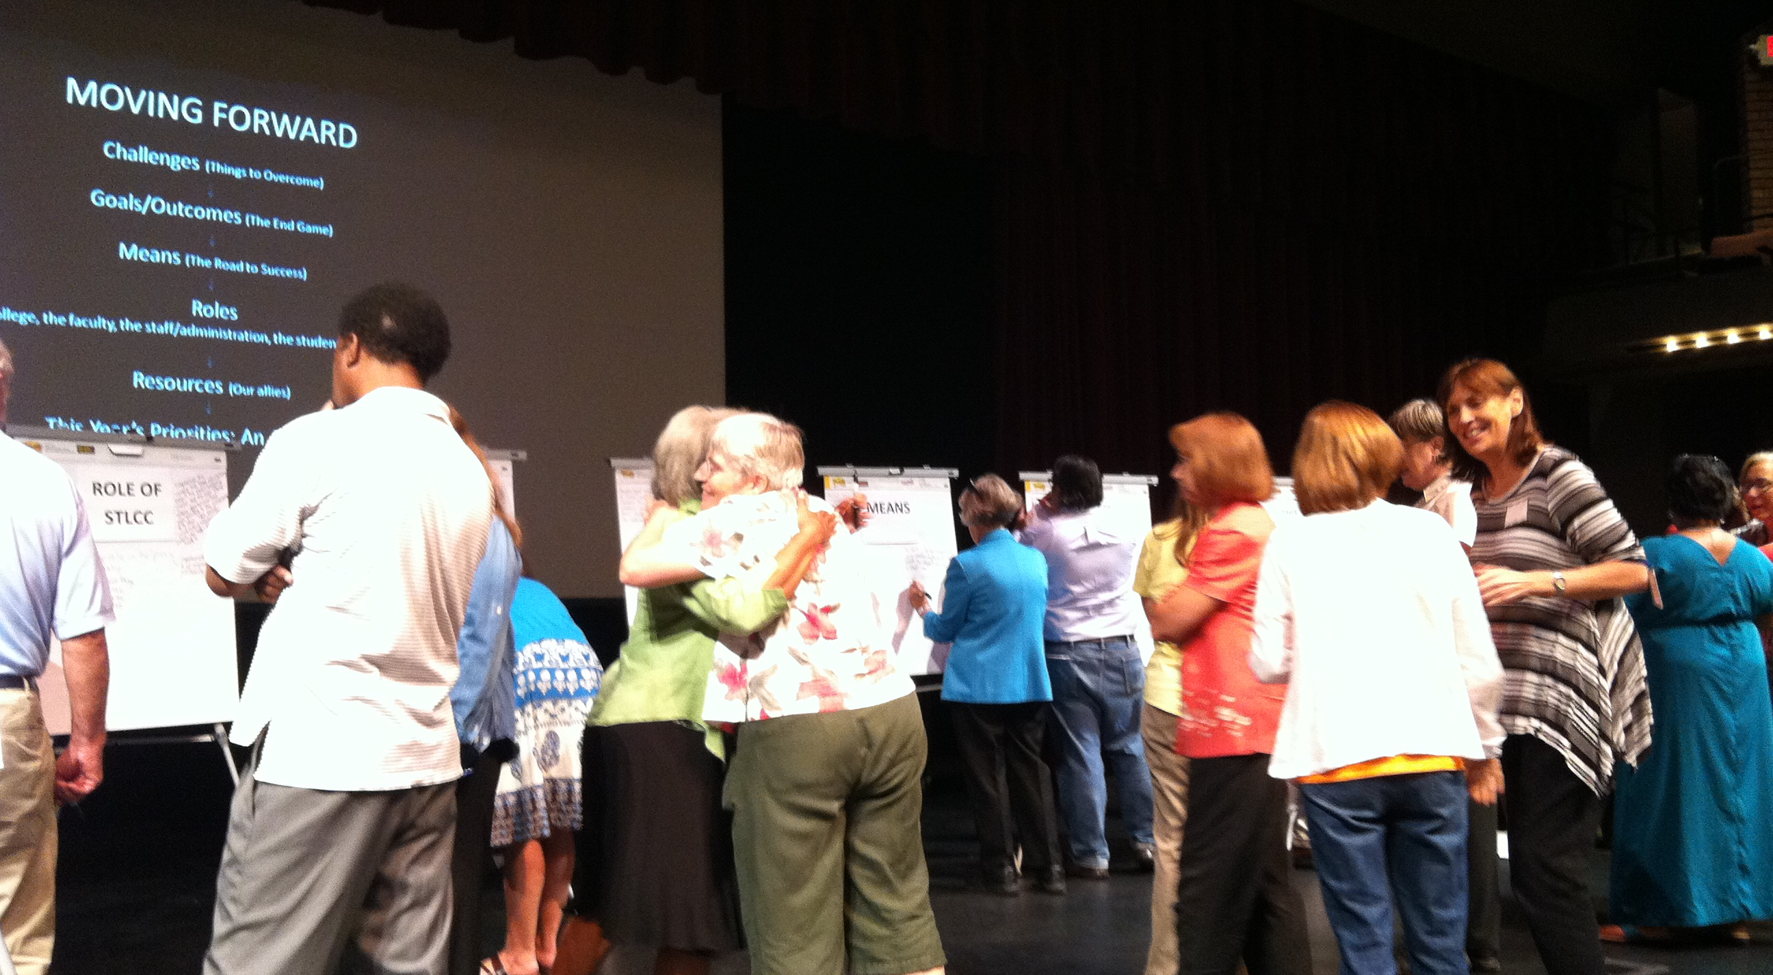

Slide 21
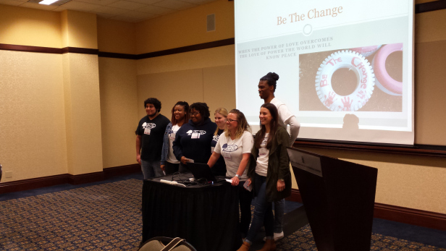

Slide 22
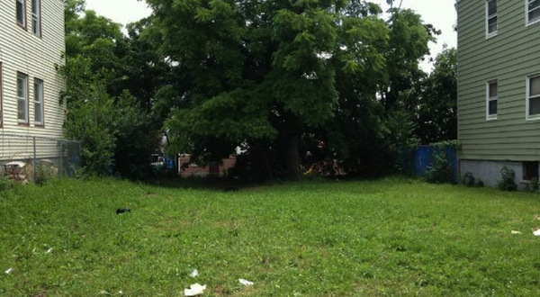

Slide 23
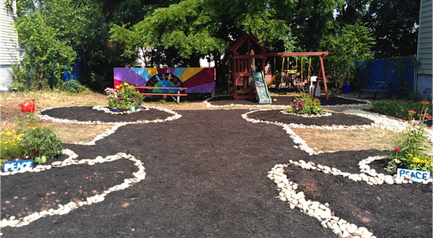

Slide 24
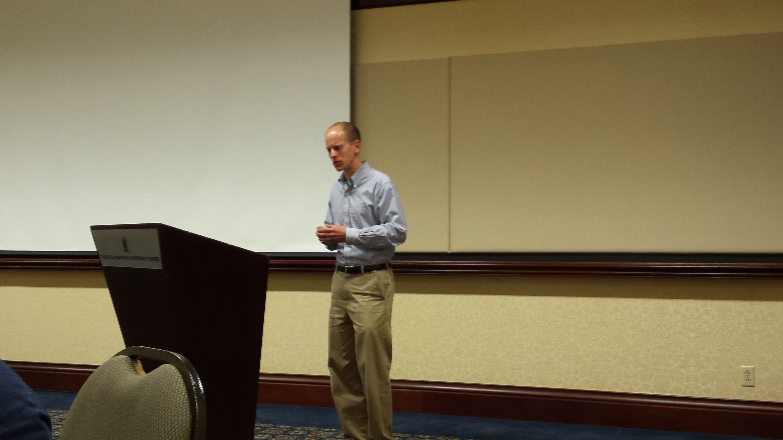

Slide 25
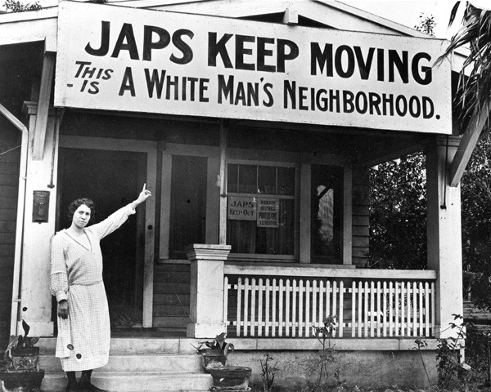
We have made strides in advancing inclusiveness
and justice, but we still have much work to do

Slide 26

2. Symbols and symbolism are important in our society.
They can connote exclusion as well as inclusion

Slide 27

3. We have an obligation to the vulnerable to our society

Slide 28
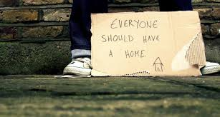
4. Diversity includes more than the generally protected kinds of differences, but includes differences based on living conditions, economic circumstances, learning styles, and behavioral abilities

Slide 29
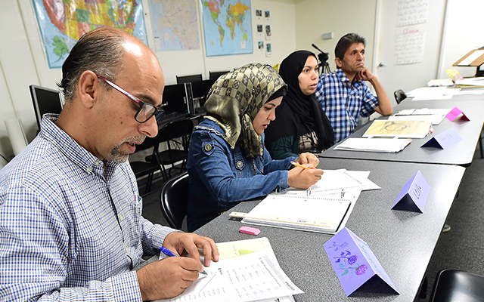
5. We need to remember that the motivation for people coming to the U.S. today is no different than in previous generations: to have a better life

Slide 30
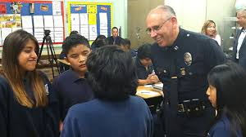
6. We need to support the work of professionals working to make our society safe and accepting. We also need to be prepared to be critical when necessary

Slide 31
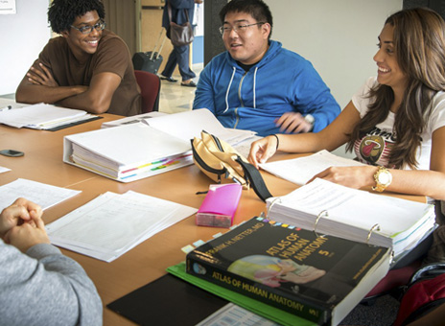
We need to continue to insure that colleges are safe places
for students to learn and share

Slide 32
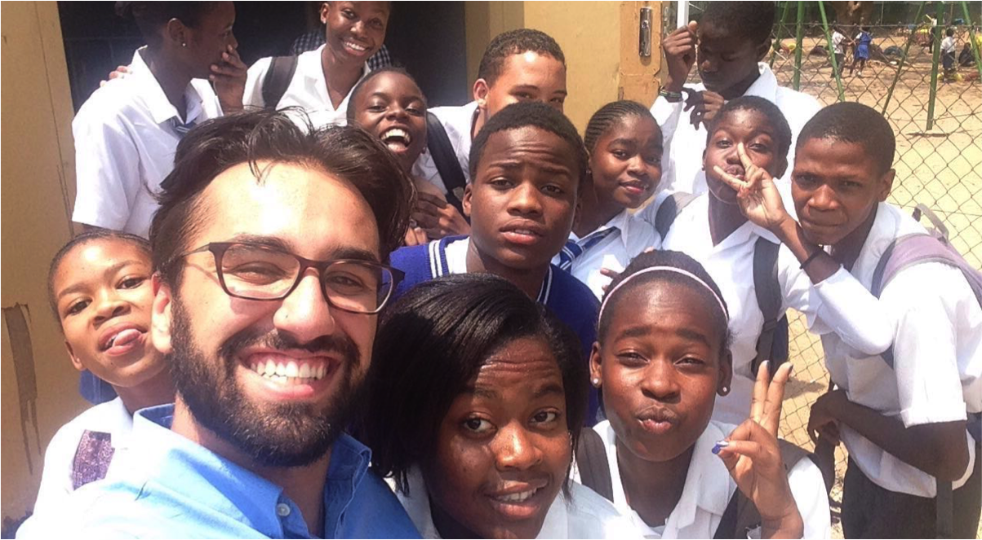
8. Never doubt that a small group of thoughtful committed citizens can change the world, indeed, it’s the only thing that ever has (Attributed to Margaret Mead)

Slide 33
