Slide 1


PEACEJ BS
How to Start a Career in Peacebuilding
David J. Smith
International Conference on Conflict Resolution Education
June 19, 2015

Slide 2
Reality Check!
Average college debt after four years?
  $29,400
Unemployment rate in 2014 for recent grads?
  8.5%
Highest in demand professions?
  Engineering/business (60%)
Least in demand majors?
  Social sciences/humanities (11 & 10%)
Highest starting salary?
  Petroleum engineering, $93,500
Percentage of students who view that going to college is about job preparation?
  86%
Percentage of students who view that going to college is about “enlightenment”?
  46%

Slide 3
All Education is Career Education

Slide 4
Career Preparation
At graduate level
  USIP SR 246: “Graduate-level academic institutions are not adequately preparing students for careers.”
At undergraduate level
  70% of faculty are providing direction
  86% of faculty believe a text for students is needed

Slide 5
Peacebuilding
Artificial dichotomies
  Global vs. domestic
  Research vs. applied
  Activist vs. facilitative
Professionals use multiple terms to characterize their work causing confusion (for students and the public)
  Conflict resolution, management, transformation
  Conflict resolution education vs. peace education
Overall expectation in field is to build peaceful relations
  Cognitive by way of “knowledge”
  Non cognitive/applied by way of “skills”
  Constitutes “peacebuilding”

Slide 6
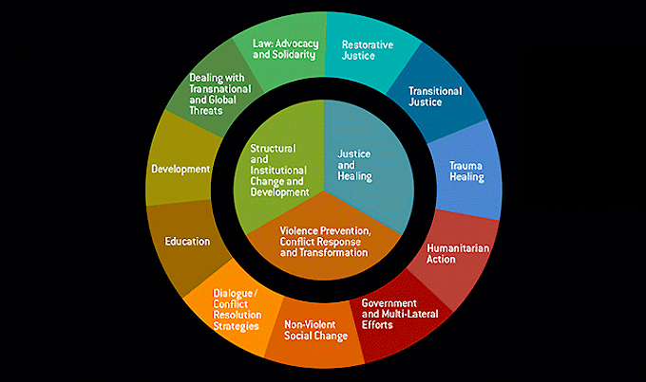
Strategic Peacebuilding Pathways
(Lederach and Mansfield)

Slide 7
Faculty/Staff
  Most come from discrete research/theoretical backgrounds
  Fewer come from practitioner backgrounds
  Faculty are at times ill-prepared to provide career direction
  Career counselors do not always understand the field

Slide 8
Students
Come with passion and excitement
Come with little realistic understanding
Generally have some interests and expectations for careers
Are not sure how their interests align with the field
Come to believe that occupations that require more education and training are only options
Dealing with parental pressure and loan repayment obligations
Results in unrealistic expectations

Slide 9
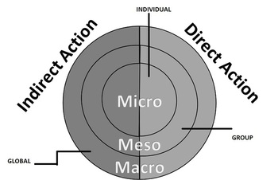
Career Framework

Slide 10
Peacebuilding Impact
Direct Action | Indirect Action
Mediator | Educator (all subjects)
Humanitarian worker | Health care worker
Diplomat | Police officer
Facilitator | Business owner
Activist | Artist
Peace educator | Soldier
 | Journalist
 | IT professional
 | Athlete

Slide 11
P.E.A.C.E
Passion
Education
Activities
Community
Environment

Slide 12
31 Autobiographies
School | Major | Job
Valencia College | Criminal justice | Domestic violence
George Mason U. | Conflict resolution | Public school mediation program
Franklin Pierce U. | International studies | State Dept.
North Carolina State U. | Political science | County teen coordinator
Portland State U. | Communication | Consultant
Bradley University | Spanish | Manager, Red Cross
Northeastern Ill. U. | Justice studies | Health worker
U. of Delaware | Latin American studies | 8th grade history teacher
UNC/Greensboro | Special education | Trainer
Santa Barbara City College | Liberal arts | Activist oriented NGO
Kalamazoo College | Social science | Started not-for-profit
U. of Maryland | Social science | Community mediation program manager
U. of Virginia | Humanities | Started dance company
U. of Hawaii | Film | Started film company

Slide 13
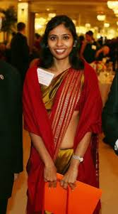

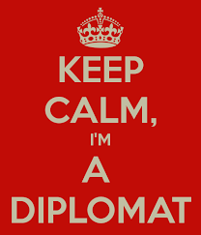

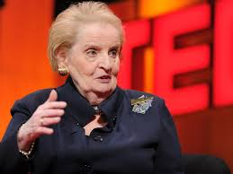
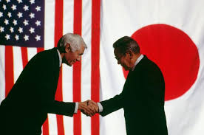

Diplomacy

Slide 14



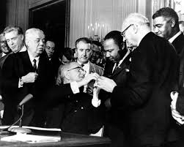
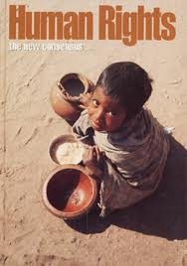
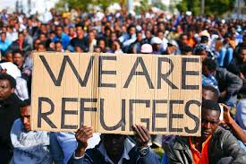
Human Rights and Law

Slide 15
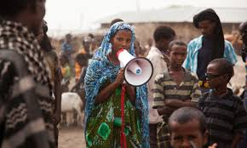
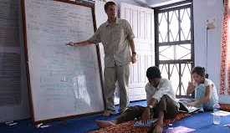
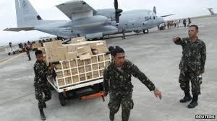
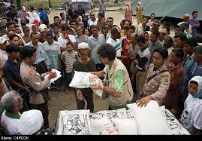
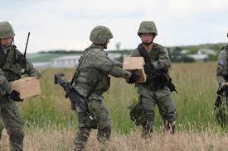
NGO, IGO, Humanitarian and Military

Slide 16

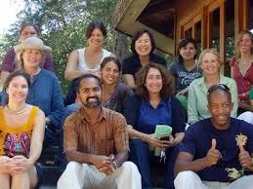
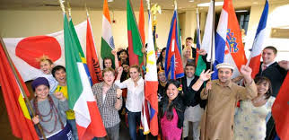

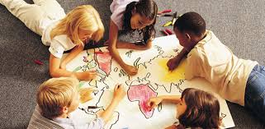
Teaching

Slide 17
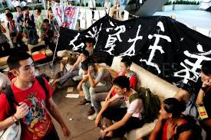

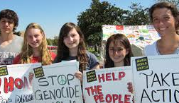
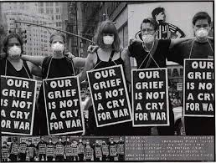
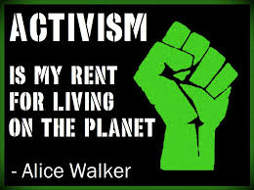
Social Justice/Activism

Slide 18
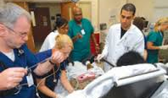
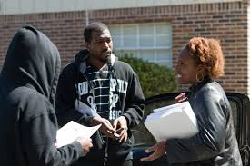
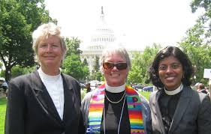
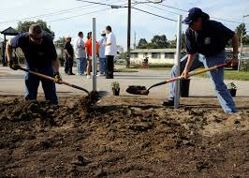
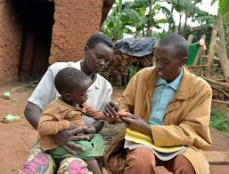
Health, Community, Faith Based (A Healing Approach)

Slide 19
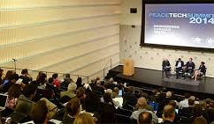

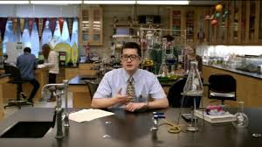

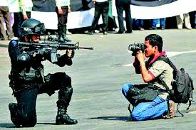
Arts, Science, Technology, Media
(Creating Peace)

Slide 20



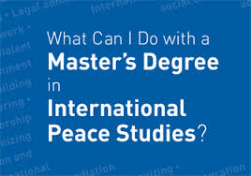
Further Education

